Slide 1
Edinburgh Business School MBA
AUC Academic Partner
Strategic Planning
Module 5 – Part 2
The Company and the Market
Instructor: Moataz Darwish, MBA

Slide 2
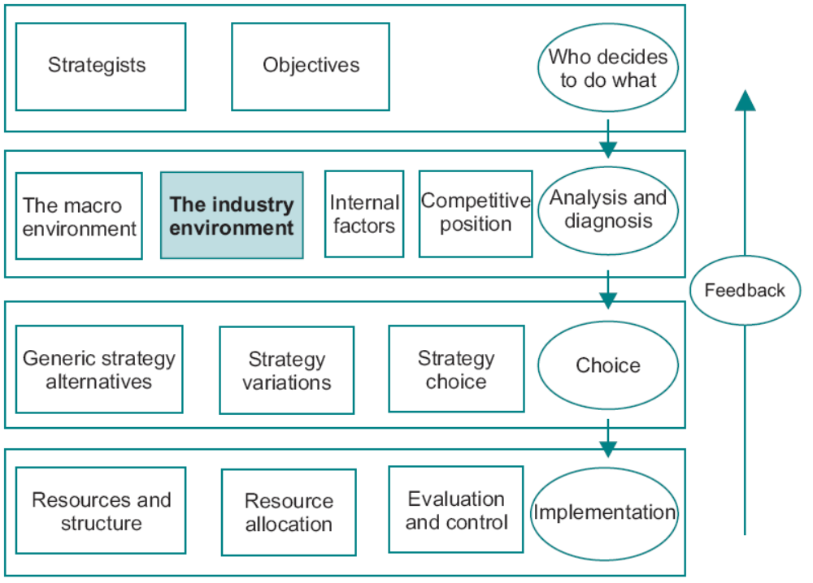
The Model
EBS MBA / AUC

Slide 3
Contents
The Market
The Demand Curve
Competitive Reaction
Segmentation
Product Quality
Product Life Cycles
Portfolio Models
Supply
Markets and Prices
Market Structures
The Role of Government
The Structural Analysis of Industries
Strategic Groups
First Mover Advantage
An Overview of Macro and Micro Models 5/61
Environmental Threat and Opportunity Profile: Part 2
EBS MBA / AUC

Slide 4
Portfolio Models
The portfolio model approach incorporates dynamics (passage of time) into the interpretation of product positioning.
EBS MBA / AUC

Slide 5
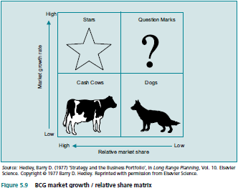
Portfolio Models
EBS MBA / AUC

Slide 6
Portfolio Models
The BCG Relative Share Growth Matrix
  Focuses on two factors:
    Relative Market Share (compared to that of its leading competitors)
      Economies of scale:
      The experience effect
      revenue and costs are significantly affected by what is happening to the total market.
    Stage of the Product Life Cycle.
Other Portfolio Models
  McKinsey portfolio model
  Business strength and industry attractiveness.
EBS MBA / AUC

Slide 7
Portfolio Models
Other Portfolio Models are:
  More complex than BCG
  More variables than BCG
McKinsey Portfolio Model:
  Business strength – ex. capacity utilization and relative costs
  industry attractiveness – ex. growth rate, profitability, cost trends and industry structure
  variables are weighted in terms of relative importance,
EBS MBA / AUC

Slide 8
Portfolio Models
Limitations of Portfolio Models
  the assumptions of the BCG model may be violated:
    ex. (The Dog may be in a market in which all sizes of company make profits; on the other hand the lack of barriers to entry may result in a Cash Cow being continually under competitive threat).
EBS MBA / AUC

Slide 9
Portfolio Models
Portfolio Models and Corporate Strategy
  Portfolio selection is not a mechanistic process based on the selection of products as they appear in the BCG matrix. There are many difficulties involved:
    portfolio decision will depend on the various risks involved, and the company’s attitude to risk bearing.
    the variables in the matrix do not capture all relevant product characteristics
    products are not conceptual entities to be guided through the stages of the product life cycle;
    A portfolio which
EBS MBA / AUC

Slide 10
Portfolio Models
Portfolio Models and Corporate Strategy
  Diversification
    comprised of totally unrelated products may be virtually unmanageable,
    there is no guarantee that the corporation is adding value by including all of them in the portfolio.
    should be linked in such a way as to benefit from the competencies of the corporation.
  Competitors analyses
    competitors can be analyzed - attack their ‘Cash Cow’! Stars!…
    analyze competitors’ reaction and predict their strategic moves.
  Principal agent problem between corporate and SBU
    a star to an SBU might be dispensable from corporate portfolio point of view.
EBS MBA / AUC

Slide 11
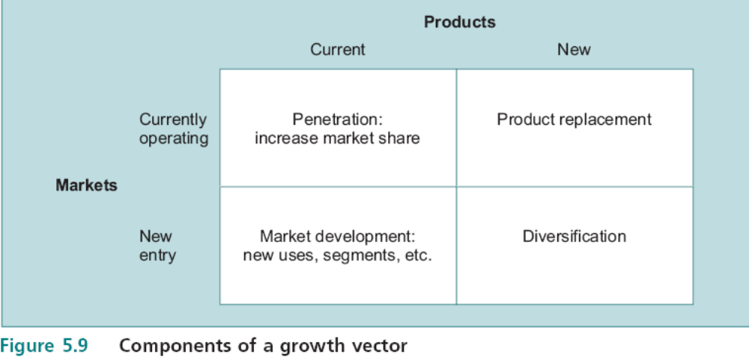
Portfolio Models
  Ansoff’s Growth Vector
    A systematic approach to identifying the components of the portfolio strategy.
    the growth vector interpret the direction in which the company intended to develop its portfolio.
EBS MBA / AUC

Slide 12
Portfolio Models
Penetration
  for the mature market, this can be interpreted as developing a dog into a cash cow, while for a growth market as developing a question mark into a star.
  growth depends on pricing and marketing strategies
  ex. Mature European car makers in the late 1990s: BMW acquired Britain’s Rover and Rolls Royce, while VW acquired Bentley.
Product replacement
  enhancement of an existing product or a totally revised version with a different set of characteristics
  key is customer satisfaction
  ex. Offroad vehicle during the 1990s
Market development
  new geographical locations / identifying unexploited segments or niches.
  requires effective market entry strategies (Daewoo’s fixed price selling in British market).
Diversification
  notion of unrelated diversification
  no direct experience of marketing strategy nor experience of production.
EBS MBA / AUC

Slide 13
Portfolio Models
Strategy and Product Information
  Think about the items of information on a product which you need to make decisions; these include:
  price elasticity
  income elasticity
  the effect of marketing on the position of the demand curve
  competitive conditions in the industry
  size and growth of the market
  relative market share
  product life cycle
The objective of a market analysis is to go beyond the immediate product characteristics and quantify the conceptual factors as far as possible.
EBS MBA / AUC

Slide 14
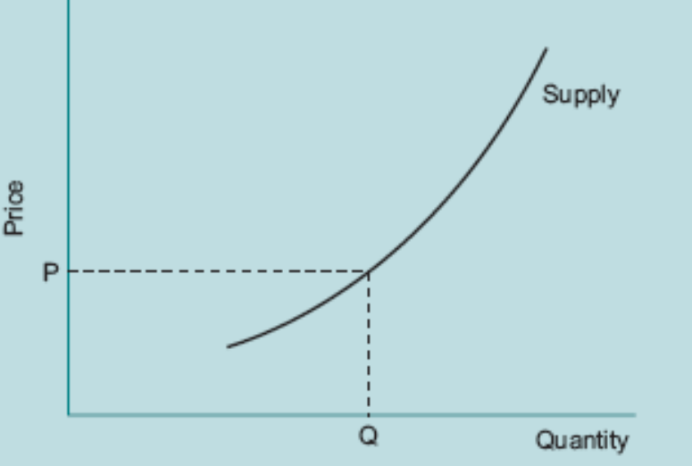
Supply
Shape of the supply curve depends on production costs;
The slope of the supply curve depends on the cost structure of the companies in the industry.
EBS MBA / AUC

Slide 15
Supply
The Industry Supply Curve and Strategy
  Many important factors that tend to change over time which affect the elasticity of the industry supply curve:
    the current level of capacity utilization,
    the cost of increasing capacity,
    the availability and wage costs of additional employees,
    the availability of raw materials,
    the potential for foreign competitors to enter the market.
Shifting the Industry Supply Curve
  Any factor which changes costs will have an effect on the supply curve – ex. price of oil.
EBS MBA / AUC

Slide 16
Markets and Prices
Prices are determined by the interaction of demand and supply.
The production of goods and services depends on the costs which companies incur in supplying different quantities.
The demand for goods and services depends on what people are willing to pay (price) for different quantities.
The interaction of demand and supply produces prices, which serve as signals to seller and buyers.
Demand and supply analysis and equilibrium price is a powerful tool both for understanding market conditions and for predicting what is likely to happen in the future.
EBS MBA / AUC

Slide 17
Markets and Prices
Ex. the shipping business
  Fluctuating vessel prices.
  Permanent feature of the shipping market (this is an example of what is known as the cobweb theory in economics).
Any factor which alters the position of the industry demand or supply curves will have an impact on market prices.
Demand and supply analysis uses the concept of equilibrium price, which does not exist in real life because transactions are taking place all the time around the equilibrium point;
  All buyers and sellers would have to have complete information about each other for all transactions to take place at the equilibrium point, and that is clearly impossible.
EBS MBA / AUC

Slide 18
Market Structures
Casual observation reveals that market structures vary markedly among industries.
It is not usually appreciated by managers that market structure is the main determinant of long term profitability,
And an understanding of market structures is central to developing strategy.
EBS MBA / AUC

Slide 19
Market Structures
  Financial markets – stock exchange, currency markets, bond markets?
  Agriculture?
  Supermarkets
  Banking industry
  Chemicals
  Oil
  Medicinal drugs
  Broadcasting
Kinked Demand Curve
Perfect
Competition
Pure Monopoly
Monopolistic Competition
Oligopoly
Duopoly
Monopoly
Less competitive (greater degree of imperfection)
The further right on the scale, the greater the degree of monopoly power exercised by the firm.
An important dimension of strategic analysis is to identify where markets are not perfect, and capitalize on these factors.
Attempt to introduce the imperfection of non-homogeneity, i.e. to differentiate the product further;
EBS MBA / AUC

Slide 20
Market Structures
Perfect Competition
In economics, a ‘perfect’ market is one where the product is:
  homogeneous,
  no barriers to entry,
  no economies of scale,
  universal availability of information on prices and quantities
  large number of sellers and buyers;
  no monopoly profits are made, i.e. firms make only the opportunity cost of capital.
  the result is that no firm can charge more than the market price and the demand curve is horizontal.
Managers should use the conditions for perfect competition as a benchmark.
Is this market model unrealistic? Consider what happened in the market for personal computers.
EBS MBA / AUC

Slide 21
Market Structures
An important dimension of strategic analysis is to identify where markets are not perfect, and capitalize on these factors.
Attempt to introduce the imperfection of non-homogeneity, i.e. to differentiate the product further;
EBS MBA / AUC

Slide 22
Market Structures
Monopoly
Only one producer, the monopolist, whose demand curve is the industry demand curve for the product.
Competitive pressures on a monopolist - monopolistic competition (tempting to enter the market)
Companies attempt to maintain their monopoly profits by capitalizing on market imperfections such as
  barriers to entry
  product differentiation.
Managers need to continually address the following types of issue:
  What is happening to the demand curve?
  What is happening to the cost curve?
  What market imperfections do we depend on for our profits?
  Are there potential market imperfections which we have not yet capitalised on?
EBS MBA / AUC

Slide 23
Market Structures
Barriers to Entry
Barriers to entry can be classified as:
  Structural (outside the control of the firm)
  Strategic (depend on specific actions undertaken by the firm to deter entry)
EBS MBA / AUC

Slide 24
Market Structures
Barriers to Entry
Structural barriers include:
  Size of the market: electricity generation and supply (natural monopoly), although this changed.
  Sunk costs: costs of exit, route set up in airlines
  Control by legislation or tacit agreement: patent protection, OPEC
  Economies of scale: long run average cost curve of the firm, entrants have to come in at a large scale otherwise they will be at a significant cost disadvantage.
  Experience effect:
    reductions in unit cost occur as the labour force learns by doing, more effective practices are adopted, materials wastage is reduced and so on;
    it becomes progressively difficult to achieve experience gains and after some time there is no further benefits at the margin.
  The difference between the experience effect and economies of scale is that new entrants will start to move up the experience curve, whereas scale economies can only be captured by increasing the size of the firm.
EBS MBA / AUC

Slide 25
Market Structures
Barriers to Entry
Strategic barriers include:
  limit pricing
  and predatory pricing
  While competition usually cannot be avoided in the long run, entry deterring strategies may provide sufficient time for the company to build up market share and achieve scale economies which might not have been possible had entrants been enticed into the market earlier.
  the long term effectiveness of such actions is doubtful.
EBS MBA / AUC

Slide 26
Market Structures
Contestable Markets
A market in which entry costs are not sunk, and exit can be achieved costlessly.
Fear of hit-and-run raids forces low prices
Perfectly Contestable Market never offers the incumbent(s) more than the normal rate of profit.
This explains why many companies which apparently have a monopoly do not actually make monopoly profits;
  Ex. Microsoft, Windows operating system & the internet browser market – accusations based on the fact that free market forces were not being allowed to play their role.
EBS MBA / AUC

Slide 27
Market Structures
Competition among the Few: Oligopoly
  few competitors in a market
  game theory, prisoner’s dilemma, and demand curve are important.
EBS MBA / AUC

Slide 28
The Role of Government
Although the market is an efficient resource allocator, there are some areas in which it does not appear to function very well.
“Market Failure” issues.
An understanding of this aspect of government is an important input into
  PEST analysis
  environmental scanning;
  scenarios
EBS MBA / AUC

Slide 29
The Role of Government
Government and Rule Making
Government and Regulating
Government and Allocating
EBS MBA / AUC

Slide 30
The Role of Government
Government and Rule Making
The framework of rules within which markets function.
    Employment law:
    Monopoly:
    Health and safety at work
    Separation of management and ownership (governance), ex. Enron
  It is not just the existence of these rules which affects companies,
  but the fact that they are liable to be changed when governments change. ex. the Thatcher government
  The fact that the framework varies significantly among countries can have significant implications for international expansion,
  It is difficult to adapt to a completely different regulatory regime.
EBS MBA / AUC

Slide 31
The Role of Government
Government and Regulating
One of the best known instances of government regulation is:
  the attempt to reduce pollution.
  Where pollution occurs, it is the outcome of ‘externalities’, i.e. costs and benefits which do not accrue to the parties involved in an exchange.
Private cost (actually paid by the company),
Social cost (the cost to the company plus the cost to the environment).
Where externalities occur there is a case for government action in some form. It may simply be to ‘internalize the externality,
If not possible, government intervention may take the form of:
  regulating output,
  setting emission standards,
  or imposing taxes designed to equalise private and social cost.
Managers should have an awareness of the externalities in their industry and whether these are likely to be subject to government regulation in the future.
EBS MBA / AUC

Slide 32
The Role of Government
Government and Allocating
Another area of market failure occurs when it is not possible to exclude non-payers from consuming a good or service.
Is that if they were to be provided by individuals or companies, the amount provided would not be optimum.
Ex. of two shipping companies
The provision of public goods is one of the legitimate roles of government.
But it is also important to the individual company, which should recognize when it is entering a market where public goods are involved.
EBS MBA / AUC

Slide 33
The Structural Analysis of Industries
In an attempt to make explicit the various factors which determine competitive conditions within an industry, Porter identified what became known as the five forces.
The basic idea is that the degree of competition, or rivalry, within an industry depends on the threats posed by potential new entrants and substitutes, coupled with the bargaining power of suppliers of factor inputs to the industry and the bargaining power of the purchasers of industry output.
The five forces are thus:
  Threat of new entrants
  Threat of substitutes
  Suppliers’ bargaining power
  Buyers’ bargaining power
  Industry competitors’ rivalry
EBS MBA / AUC

Slide 34
Porter Five forces
Potential
Entrants
Threat of New
Entrants
Industry
Competitors
Bargaining Power
of Suppliers
Bargaining Power
of Buyers
Industry
Suppliers
Buyers
Rivalry among existing firms
Threat of
Substitute Products
and /or Services
Substitutes
EBS MBA / AUC

Slide 35
The Structural Analysis of Industries
Porter’s view is that:
  the collective strength of these competitive forces determines the ability of firms in an industry to earn rates of return on investment above the opportunity cost of capital.
  there is a close connection between the five forces approach and the analysis of perfect competition in section 5.10.1;
EBS MBA / AUC

Slide 36
The Structural Analysis of Industries
  Threat of new entrants
    Economies of scale:
    Regulation:
    Entry price:
    Technological factors:
  Threat of substitutes
    Depends on technological progress.
    One way of assessing the potential for substitutes is to use the product characteristics approach to assess whether there are characteristics of the final product which uniquely depend on the production process.
    Reduce the total size of the market,
  Suppliers’ bargaining power
    Depends on the degree of competition in supplier markets,
    It is clearly important to determine whether the firm is paying more or less for its inputs than other firms in the industry.
    Monopoly:
    Monopsony:
EBS MBA / AUC

Slide 37
The Structural Analysis of Industries
  Buyers’ bargaining power
    To have some knowledge of the characteristics of demand and buyer power.
    Price elasticity:
    Income elasticity:
    Information:
    Brand identity:
    Buyer groups:
  Industry competitors’ rivalry
    Large number of relatively small firms: approximates to perfect competition.
    A few large firms: competition among the few, with implications for competitive reaction.
    One dominant firm: monopoly or price leadership.
    Another dimension is the extent to which firms are able to segment the market by differentiating their product.
EBS MBA / AUC

Slide 38
The Structural Analysis of Industries
Profiling the Five Forces
Consider two companies ex.
Company 1 2
Threat of new entrants High Low
Threat of substitutes High Low
Bargaining power of suppliers Low High
Bargaining power of buyers Low High
Industry rivalry Low High
EBS MBA / AUC

Slide 39
The Structural Analysis of Industries
Company 1
Will focus on potential competitors and technological change.
It will be able to obtain competitive prices from suppliers through the operation of market forces and it will probably enjoy a high degree of brand loyalty.
It will not be subject to significant price competition.
Company 2
Will focus on trying to get better deals from suppliers, marketing aggressively to buyers, and on its cost and price position relative to competitors.
It will not be concerned with changes to the market either from new entrants or from substitute products.
EBS MBA / AUC

Slide 40
The Structural Analysis of Industries
Now consider the case where the profiles refer to the same company, where the first profile is where the company is now and the second is the scenario which the CEO predicts will apply within the next three years.
This expected change in the profile would be the outcome of analyzing the PEST framework and environmental scanning.
This insight into a change in the five forces profile should cause the company to start changing its focus in the expectation of significant changes in the market.
It is often found in practice that a major cause of company failure is the lack of recognition of changes in the balance of competitive forces and the consequent lack of appropriate action.
EBS MBA / AUC

Slide 41
Strategic Groups
Many firms in an industry but not all of them may be direct competitors. One approach is to identify strategic groups.
Sets of firms in an industry which are similar to one another and different from firms outside the group on one or more key dimensions of their characteristics and strategy.
Difficult to apply in practice because of the many variables which could be used to classify competitors
  organization (scale, degree of vertical integration or
  diversification, distribution channels),
  product characteristics (quality, image, level of technology)
  or even financial structure (return on assets, gearing).
EBS MBA / AUC

Slide 42
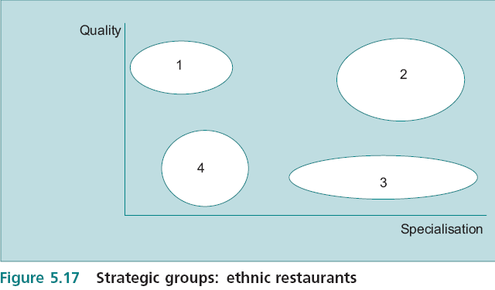
Strategic Groups
It is necessary to use a degree of imagination in order to obtain insights into the strategic groupings within the industry. For example, two important variables might be identified and mapped against, example is in the restaurant business.
This example uses two characteristics of product differentiation to identify the strategic groups of a group of restaurants.
EBS MBA / AUC

Slide 43
First Mover Advantage
in terms of the product life cycle it means the company that invented the product and brought it to market.
In normal usage it often refers to companies that entered in the introductory stage or in the early growth stage. This discussion assumes that the first mover is the inventing company, but the discussion applies equally well to other early entrants.
Not all innovators are successful and are quickly overtaken by imitators.
A potential advantage may be gained from economies of scale and the experience effect.
There are significant costs associated with being first mover. These include
bearing the costs of experimentation and failure, developing production techniques
and marketing the unknown product to bring it to the attention of consumers.
A later entrant sometimes gains ‘second mover advantage’ by not having to bear the same level of R&D, failure and risk and with consumer awareness having been aroused by the first mover.
EBS MBA / AUC

Slide 44
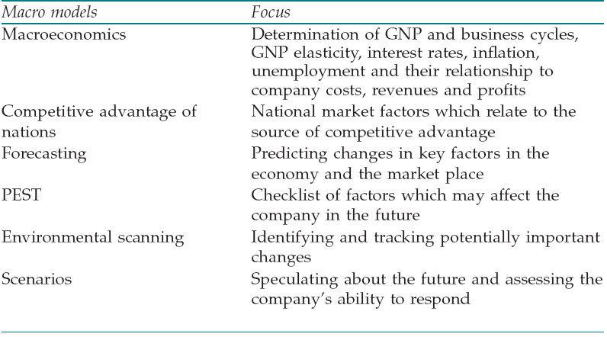
An Overview of Macro and Micro Models
There is a battery of models which can be used to analyze the environment.
EBS MBA / AUC

Slide 45
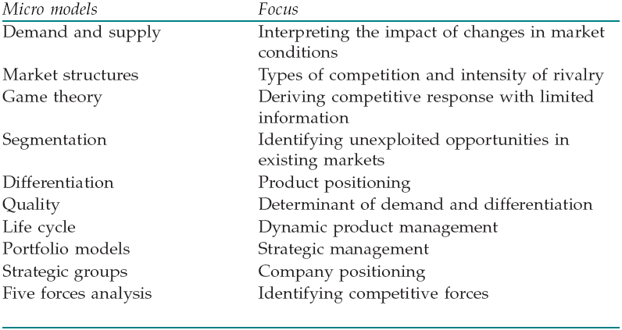
An Overview of Macro and Micro Models
The macro models are used to identify trends and changes in the variables which affect the market in which the company operates;
The micro models are specific to the industry and identify the company’s position within its immediate competitive environment.
EBS MBA / AUC

Slide 46
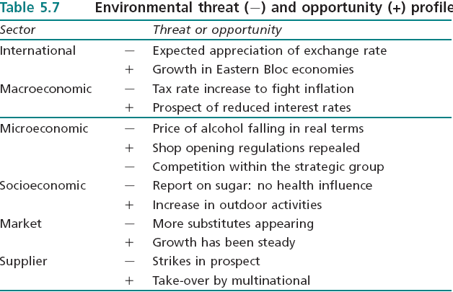
Environmental Threat and Opportunity Profile: Part 2
The idea of the ETOP was introduced at 4.9 as a method of systemizing diverse information in order to formulate an overall strategic view.
While the ETOP has not provided ready made answers to strategy, it has enabled us to bring together many ideas in a framework which makes it possible to identify key issues in context.
EBS MBA / AUC

